Slide 1

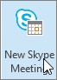
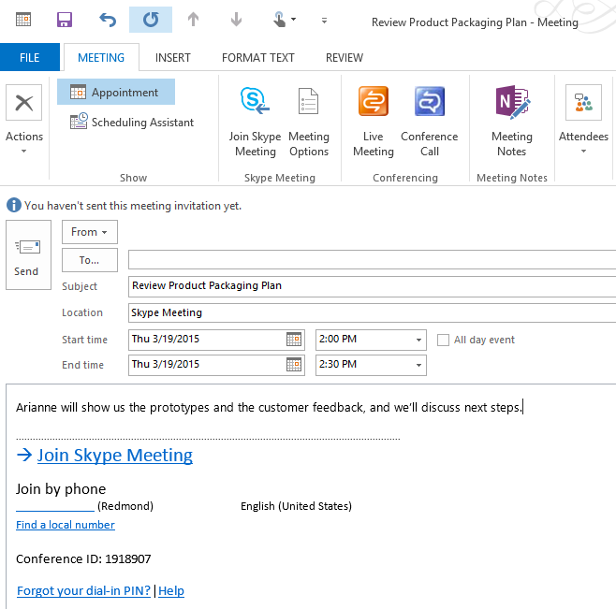
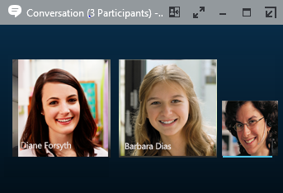
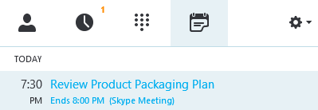
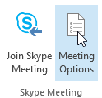
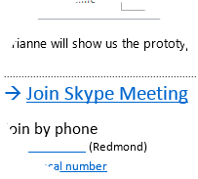
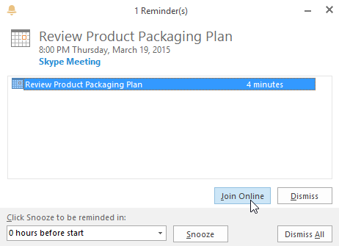
Choose your view
In the conversation window, click the Pop out video gallery arrow.
Skype for Business (Lync)
Quick Start Guide
Meetings
1
Meetings
Schedule a Skype for Business meeting (from Outlook)
Click the Pick a layout button and choose a view:
Gallery View shows everyone’s video streams
Speaker View shows only the presenter’s.
1
Open your Outlook Calendar, click the Home tab, and click New Skype Meeting. (If you are in Skype for Business (Lync) mode, this button still says New Skype meeting.)
Content View shows only the meeting content.
Compact View shows pics of the participants in a compact window.
Pam McCullough
Complete the meeting request just like you normally would.
2
3
4
2
Click Full Screen View for a large view of the video streams.
Click Pop in the video
Conversation 3 (Participants)
gallery to show the gallery in the conversation window again.
Join a Skype Meeting—There are so many ways!
Add your attendees
In the main window, click the Meetings tab, then double-click the meeting you want to join.
This is added automatically. Attendees will click the Join Skype Meeting link to join the meeting.
Add your agenda or meeting info
1+(425) 555-1212
In the meeting request, click Join Skype Meeting.
Set meeting options (optional)
Dedicated Meeting Space (less secure) recommended for typical meetings Your own meeting room — it always has the same ID and permissions.
A New Meeting Space (more secure) recommended for large meetings, Webinars, etc. Set meeting options such as access, presenters, sharing and so on. In the meeting request, click Meeting Options, click A new meeting space (I control permissions).
TIP: If you mute all attendees, remember to unmute yourself when you begin!
In a meeting reminder, click Join Online.
Join via Audio only
Dial the conference number listed in the invite.
Enter the Conference ID. If asked for a PIN, enter it.
Join an online meeting from Good Mobile
In the invite, click the phone number provided. (If list appears, select None.)
When prompted, enter the Conference ID listed in the meeting invite.
NOTE: International callers, those joining via an NM phone with a 6 digit extension (enclaves or touch-down cubicles), or those calling from an NM shared number (facilities, security), must call in by dialing the conference phone number and ID.
© 2015 Microsoft Corporation. All rights reserved.

Slide 2
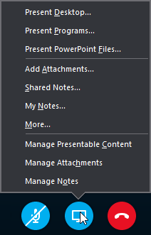
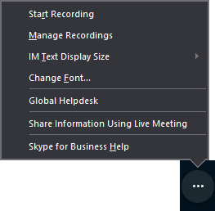
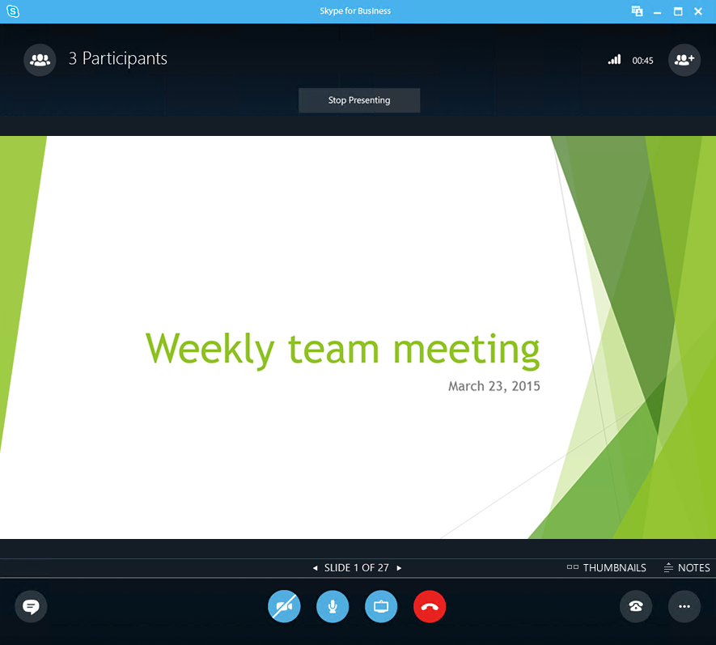
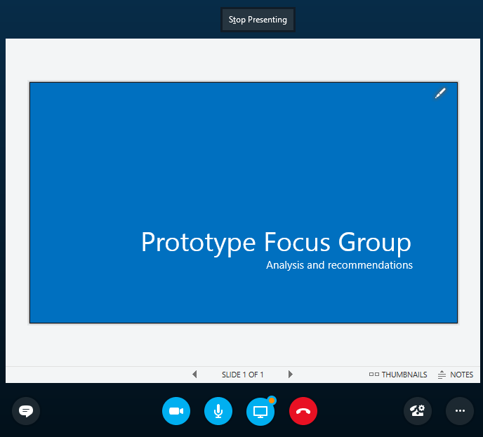

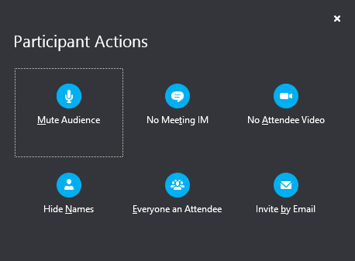

Share your desktop or a program
Need to show everyone what you’re talking about?
Record and play back a meeting
2
It’s easy to capture audio, video, IM, and what’s being presented.
In the meeting window, click the More Options button.
Click Start Recording.
After the meeting, go to Manage Recordings to publish, play, rename, or delete.
In the meeting window, click the Present button.
Click Present Desktop to show the entire contents of your desktop, or click Present Programs and double-click the program you want to share.
2
3
IMPORTANT: Supervised/Registered persons should not record Online Meetings, nor should they participate in Online Meeting sessions that are recorded.
All users should refrain from recording Online Meetings that involve confidential or sensitive information. When recording an Online Meeting, presenters should inform all meeting participants that the session will be recorded.
1
1
Share a PowerPoint presentation
Manage meeting participants
In the meeting window, click the Present button.
Click Present PowerPoint Files.
Browse to the file you want to present and click OK.
Meeting getting unruly? If you’re the presenter, you are in control.
Click the Participants button to open the Participants pane so you can see a list of everyone in the meeting.
Click the Participant Actions button.
Click one or multiple buttons to apply these settings to all attendees.
Need to invite more people?
Click this:
See the presenter’s notes (just you—no one else can see them)
Advance to the next slide
Show thumbnails of the slides, and select the next one to present
Done presenting?
Click this:
V 4.27.2015

